Slide 1
Writing Commands that use Pipeline The Pipeline Input and Output
Module 05

Slide 2
Understanding Pipeline Parameter Binding
Lesson 1

Slide 3
How PowerShell passes data down the pipeline
Whenever you string two commands together, PowerShell has to figure out how to get the output of the first command to the input of the second command.
PS C:\> CommandA | CommandB
PS C:\> Get-Content .\computers.txt | Get-Service
When Get-Content runs, it places the computer names into the pipeline. PowerShell then has to decide how to get those to the Get-Service command.
Commands can only accept input on a parameter.

Slide 4

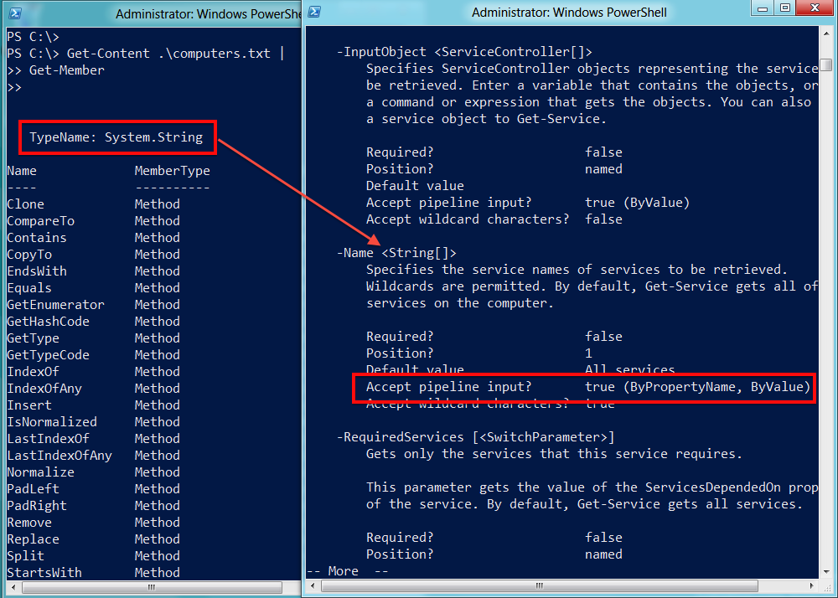
Plan A: Pipeline input ByValue
PS C:\> Get-Content .\computers.txt | Get-Service | gm

Slide 5
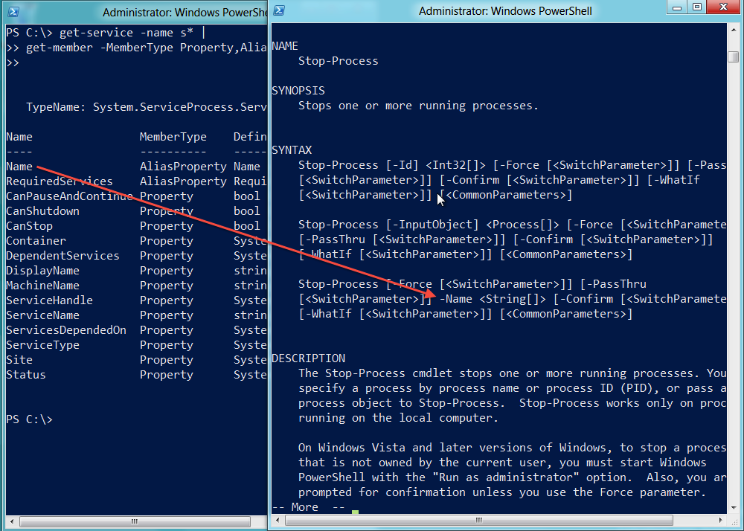
Plan B: Pipeline ByPropertyName
PS C:\> Get-Service -name s* | Stop-Process

Slide 6
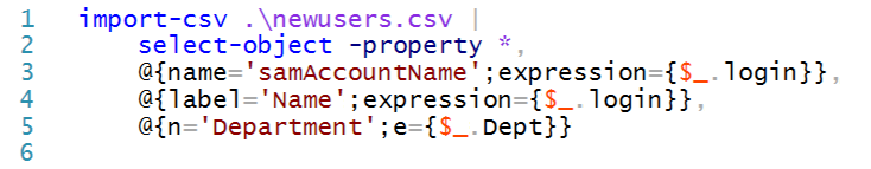
When things don’t line up: custom properties
PS C:\> Import-csv .\newusers.csv | New-Aduser

Slide 7
Parenthetical commands
Sometimes you can’t make pipeline input work.
Parentheses mean “do this first.”
PS C:\> Get-WmiObject -class Win32_BIOS `
-ComputerName (Get-Content .\computers.txt)
Sometimes you need to extract the values of the objects’ properties
Get-Service -computerName (get-adcomputer -filter * `
-searchbase "ou=domain controllers,dc=company,dc=pri" | Select-Object -expand name)

Slide 8
Implementing Pipeline Input
Lesson 2

Slide 9
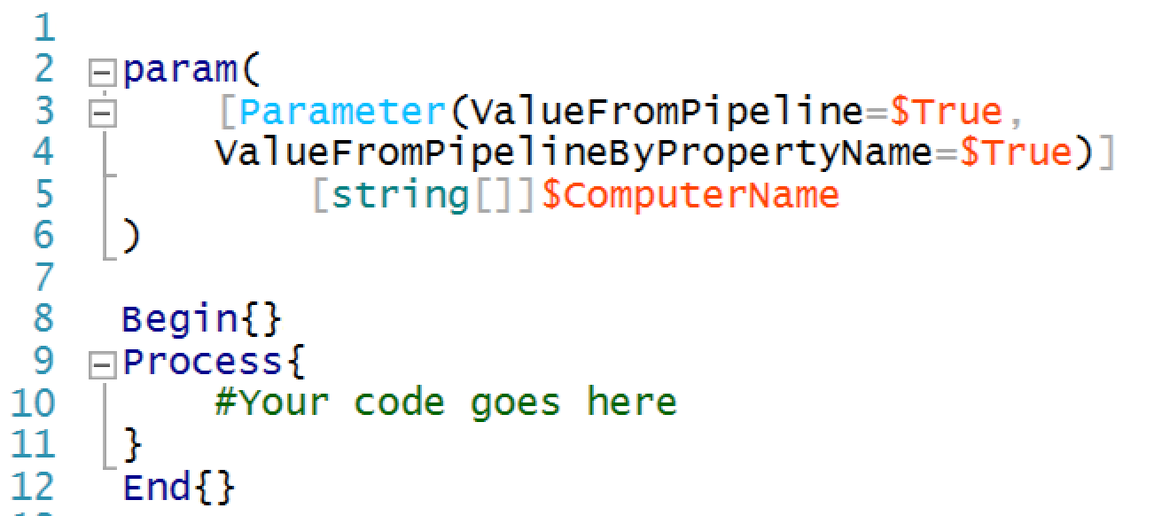
Supporting pipeline input

Slide 10
Implementing Pipeline Output
Lesson 3

Slide 11
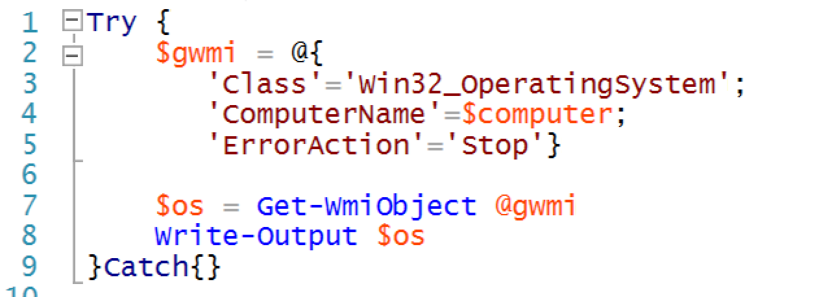
Spatting

Slide 12
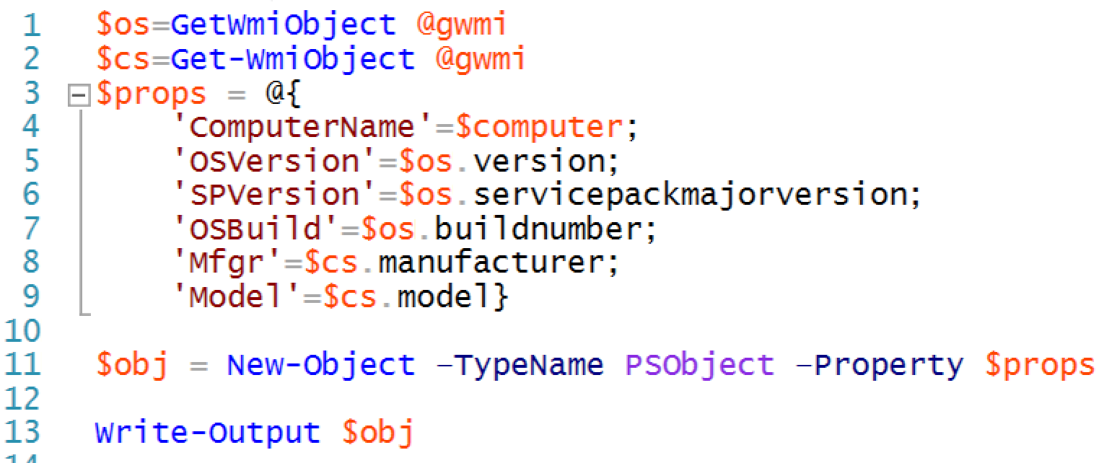
Adding more data sources

Slide 13


Lab A
60 Minutes
CLIENT
MEMBER
DC
Administrator P@ssw0rd

Slide 14
Conclusion
Your functions are now behaving more like “real” PowerShell commands. They handle errors, deal with pipeline input, and produce appropriate pipeline output.
But so far you have only created simple, “flat file” pipeline output. You also need to learn how to create more complex, hierarchical output and we will tackle that next.

